Slide 1

App Design

Slide 2
ASPEKTE
(Loading Screen)
Main Menu
Logo / ICON
3 Kamera Modi
GUI
Ausfahrbares Scoreboard

Slide 3


Slide 4


Slide 5


Slide 6


Slide 7


Slide 8
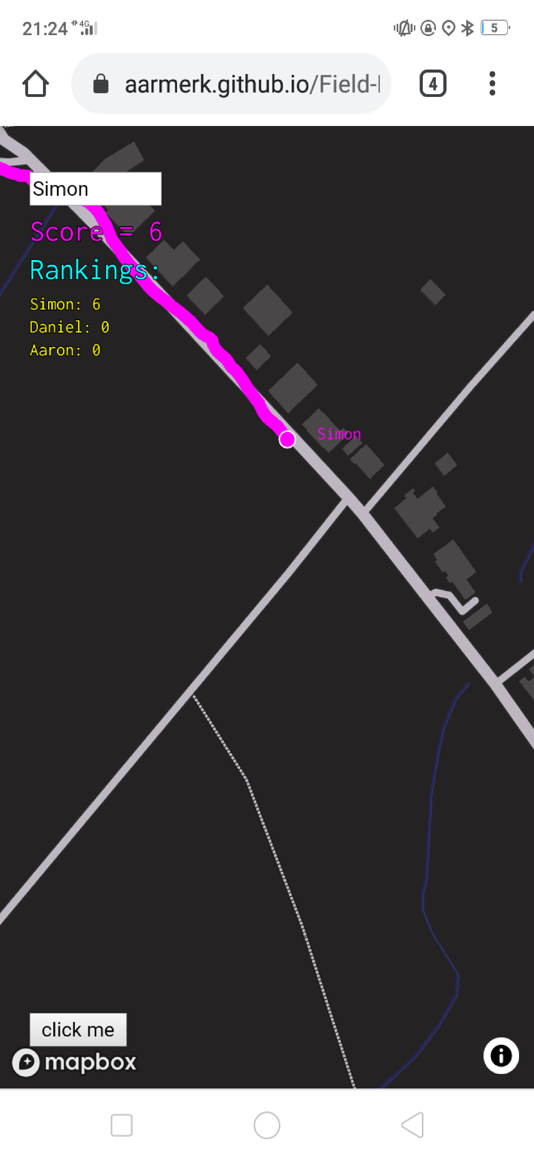

Slide 9
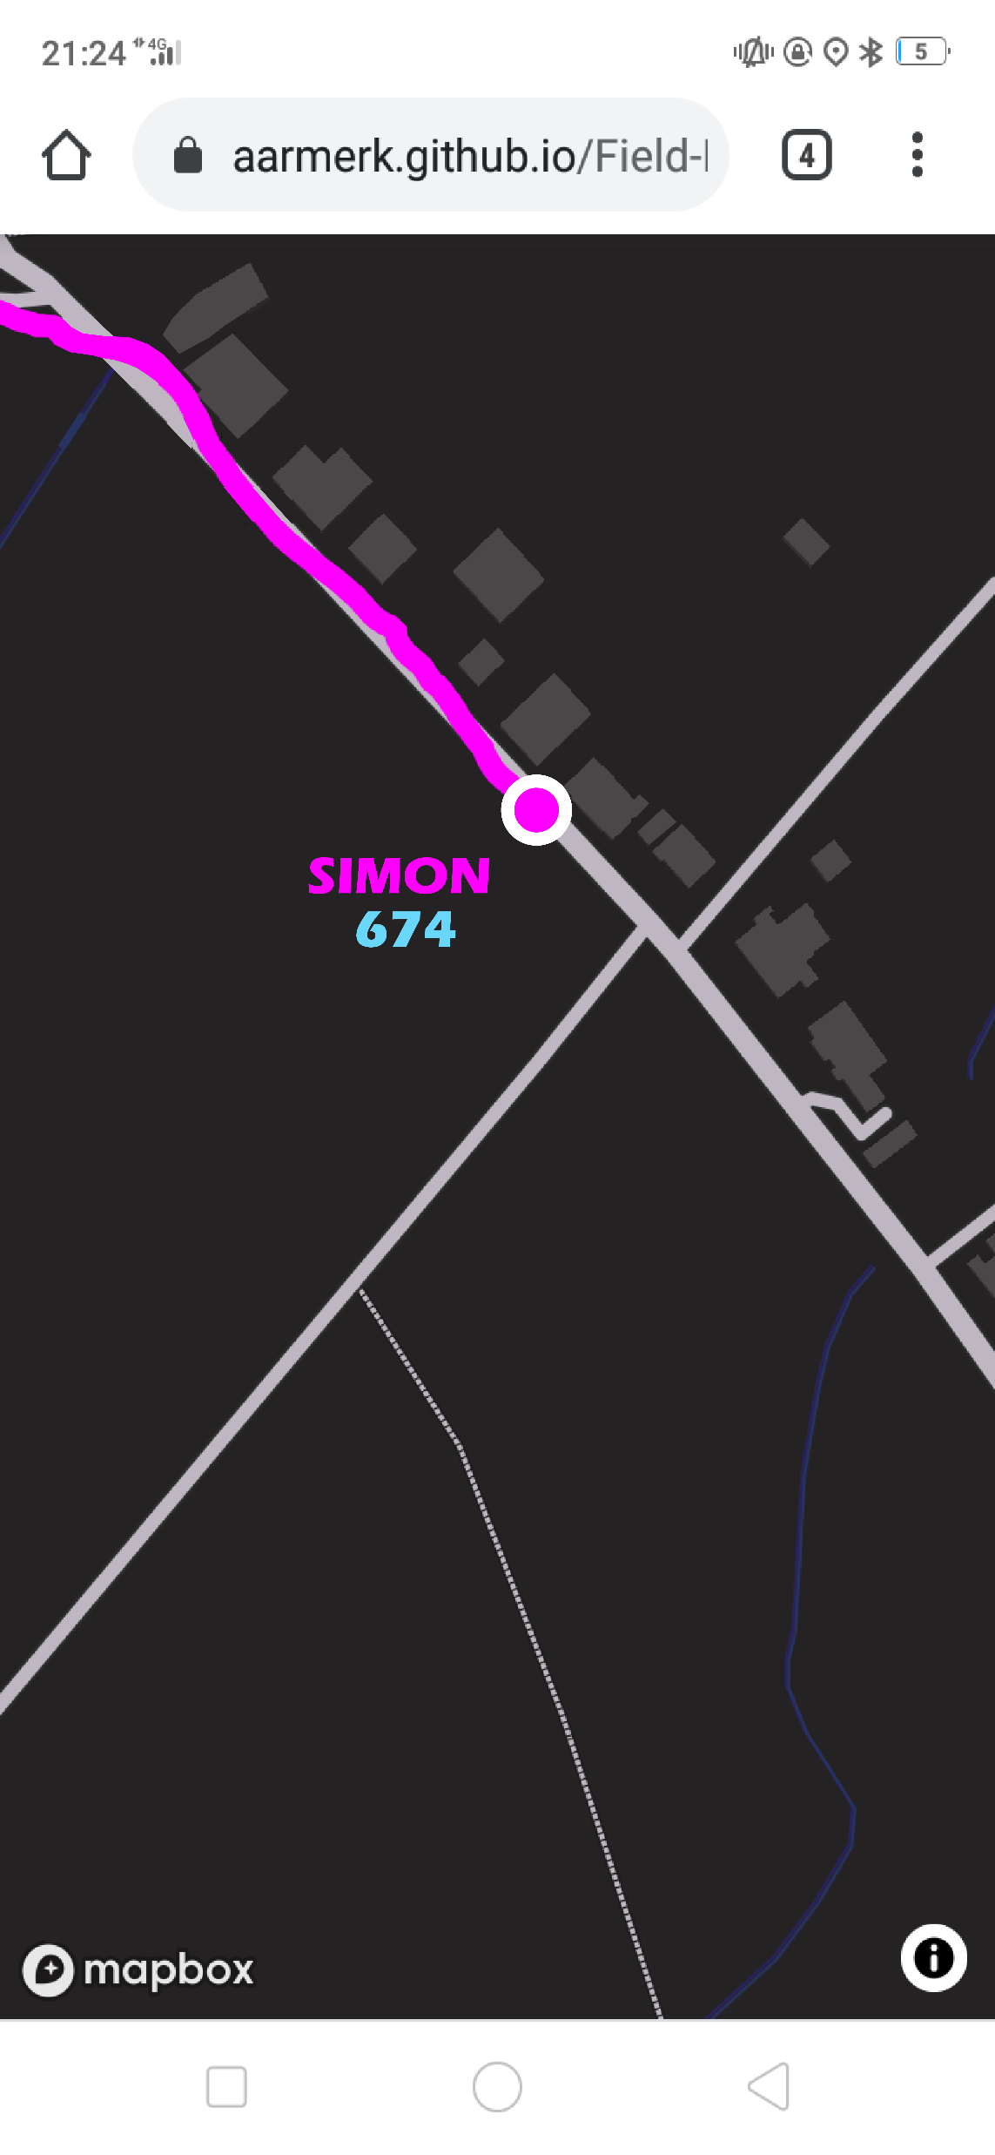

Slide 10
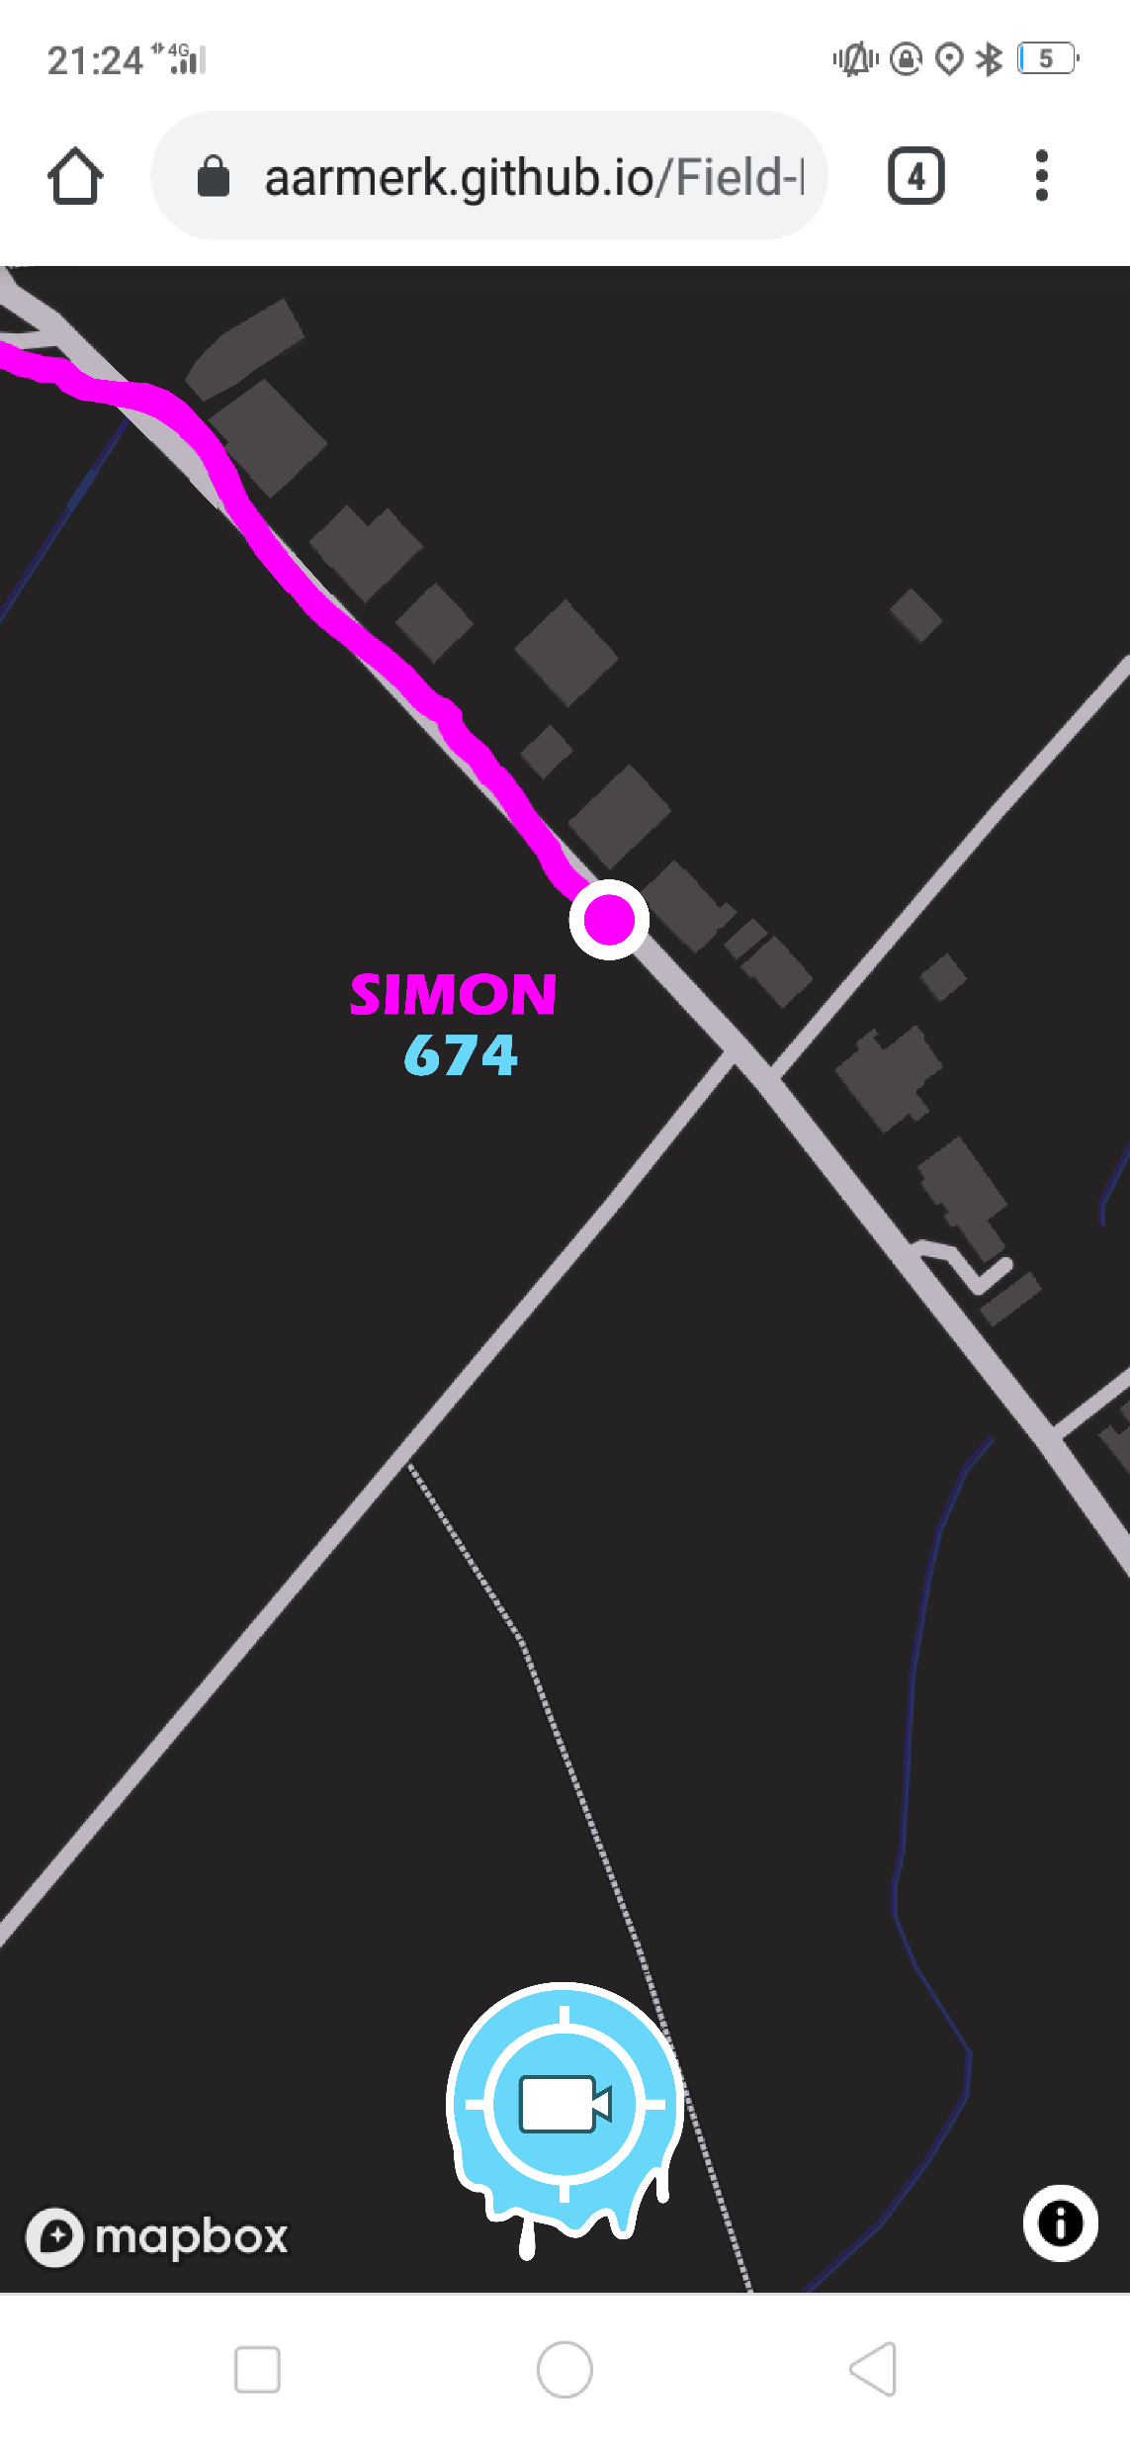

Slide 11
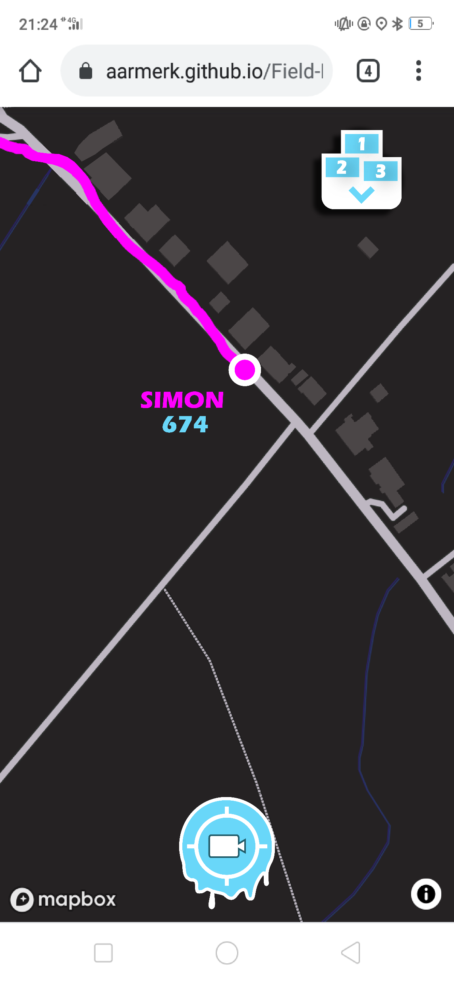

Slide 12
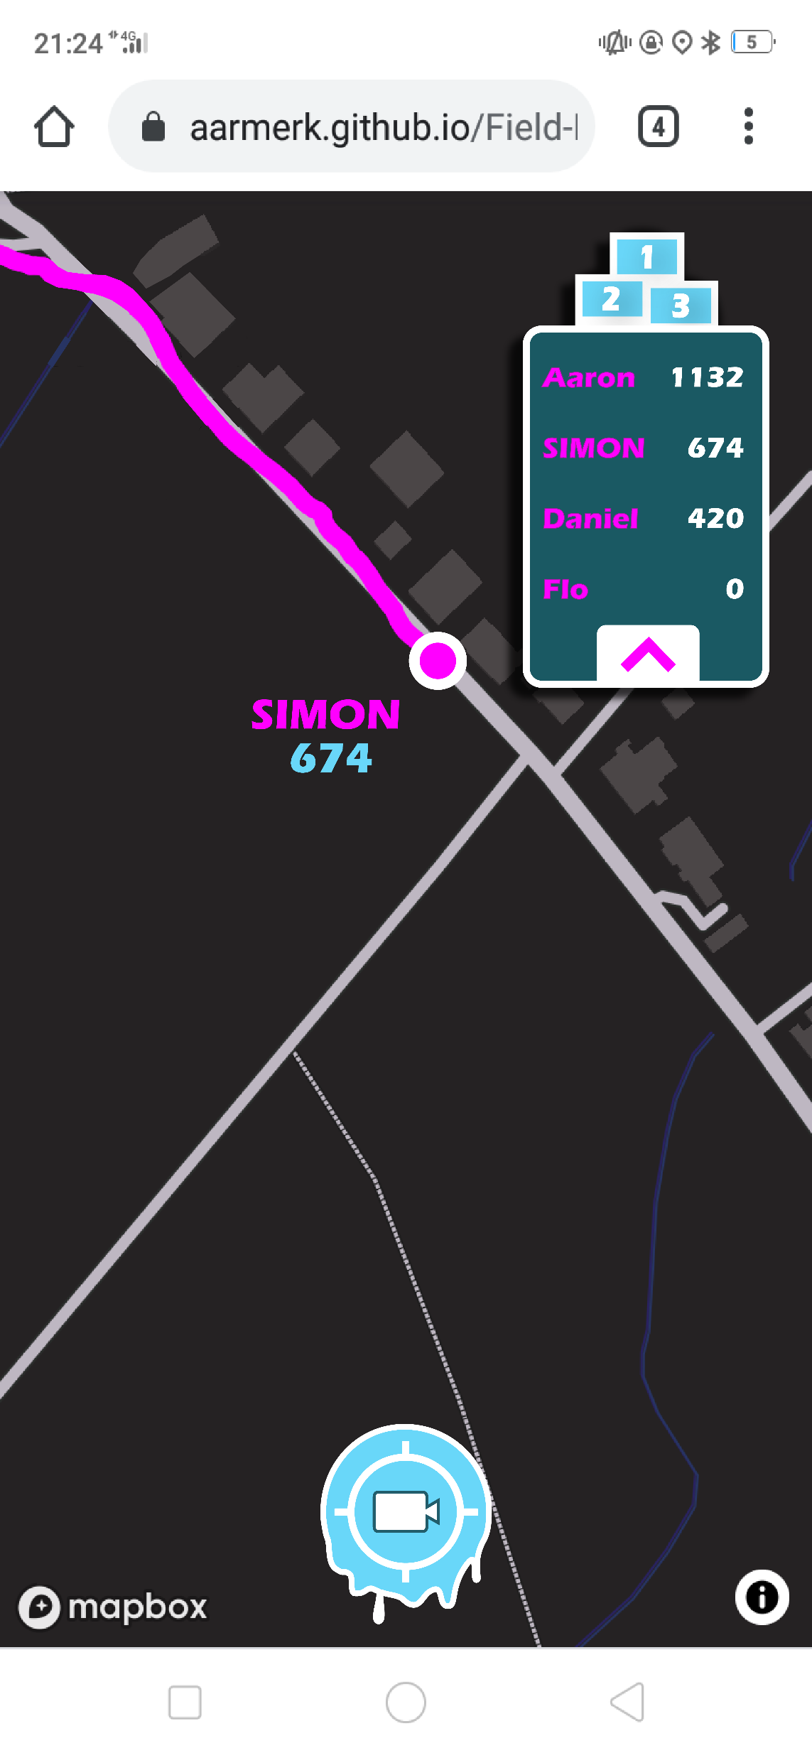

Slide 13
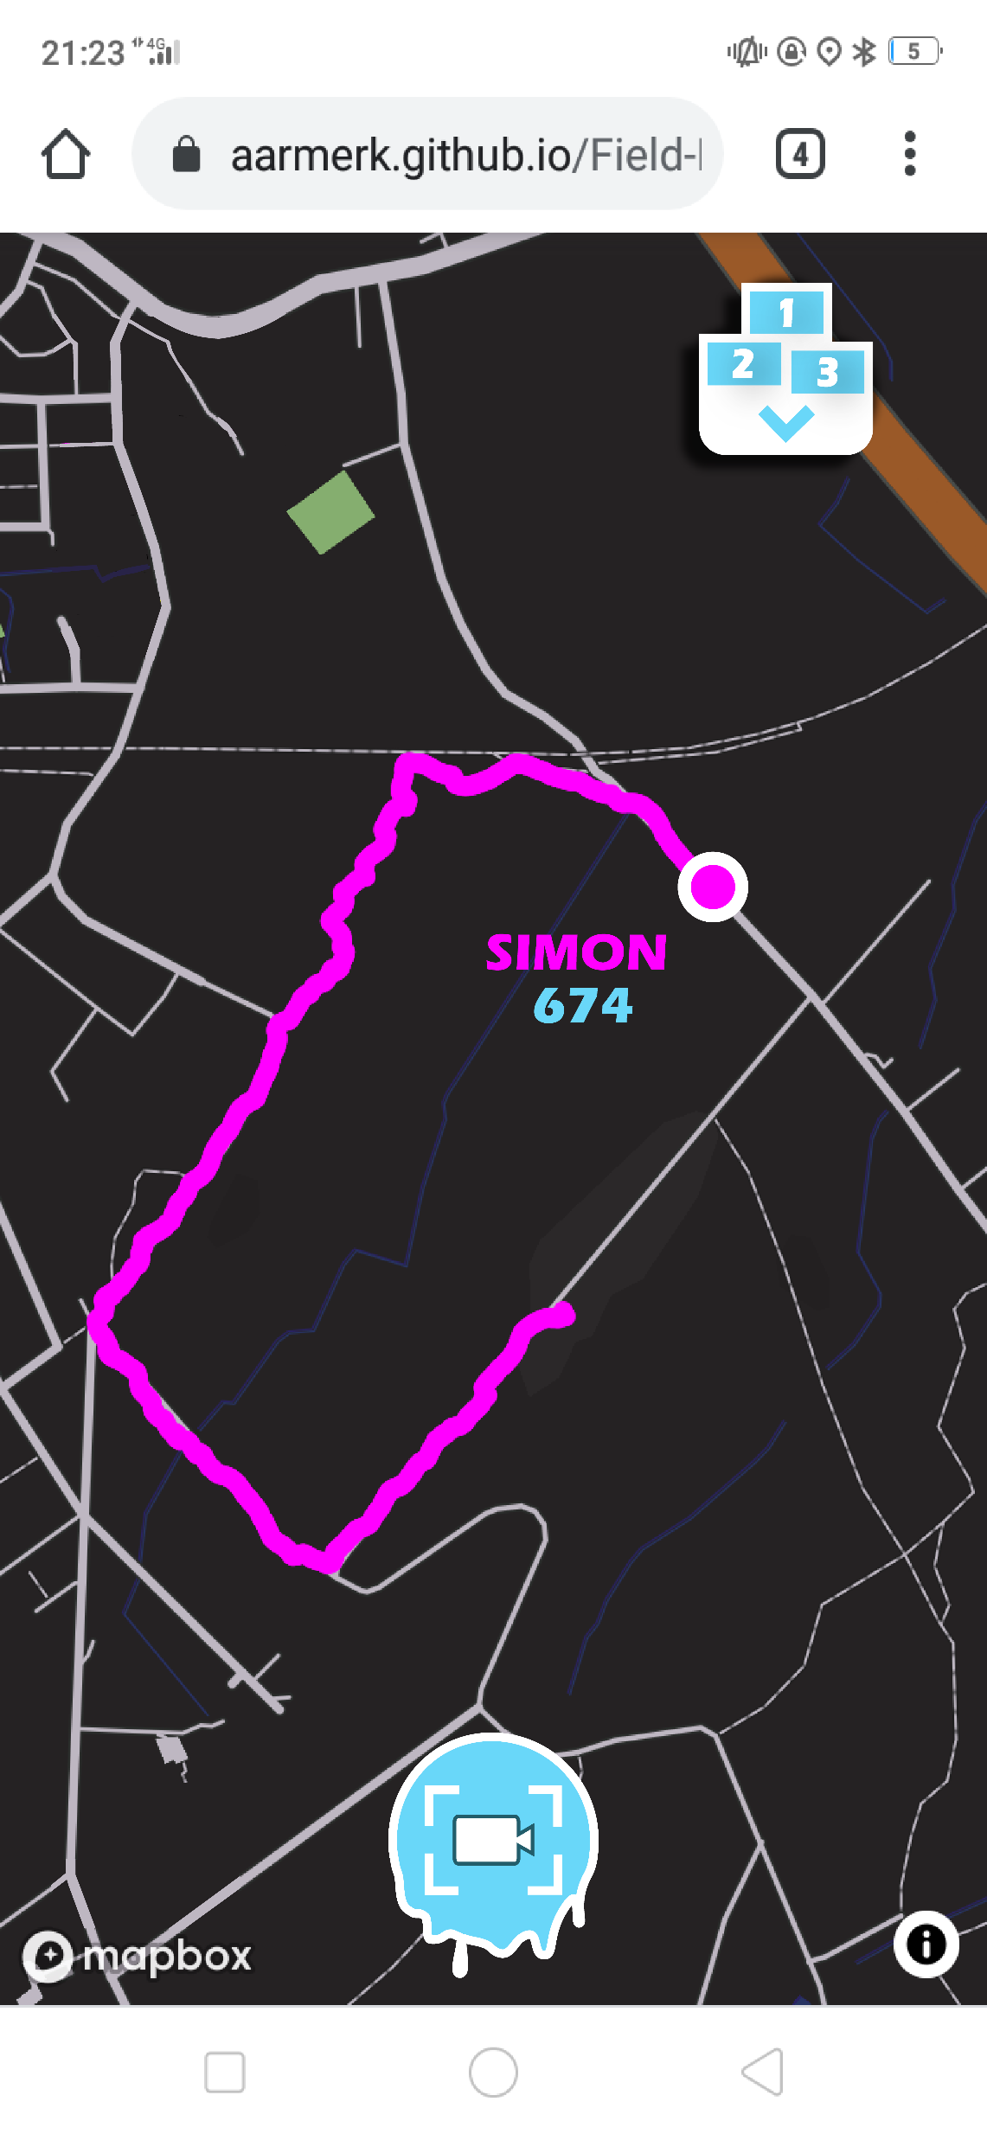

Slide 14
